Slide 1


Slide 2
Platform
Quality of Care
Goal 1: Organize a set of standards for all that includes all the facets of quality: timely, holistic, client-centered, family-centered, strengths-based, research-based and culturally/linguistically competent.
Strategy 1: Create a consumer panel to inform quality of care practice
Strategy 2: Make current research and community-based training on best practices available to all providers.

Slide 3
Platform
Quality of Care
Goal 2: Create a culture of accountability for the workforce, starting with people who provide mental health intervention and then moving to people who come in contact with those who need mental health services.
Strategy: Individual agencies hold their staff accountable to the community with standards of quality care through annual evaluations

Slide 4
Platform
Quality of Care
Goal 3: Within five years, all providers/agencies will have implemented a highly individualized transition planning process.
Strategy 1: Initiate transition planning early in the treatment process and identify individual barriers to continuity of care
Strategy 2: Evaluate and assess best practices for after-care services
Strategy 3: Establish a framework of transition planning for all agencies (traditional and non-traditional stakeholders

Slide 5
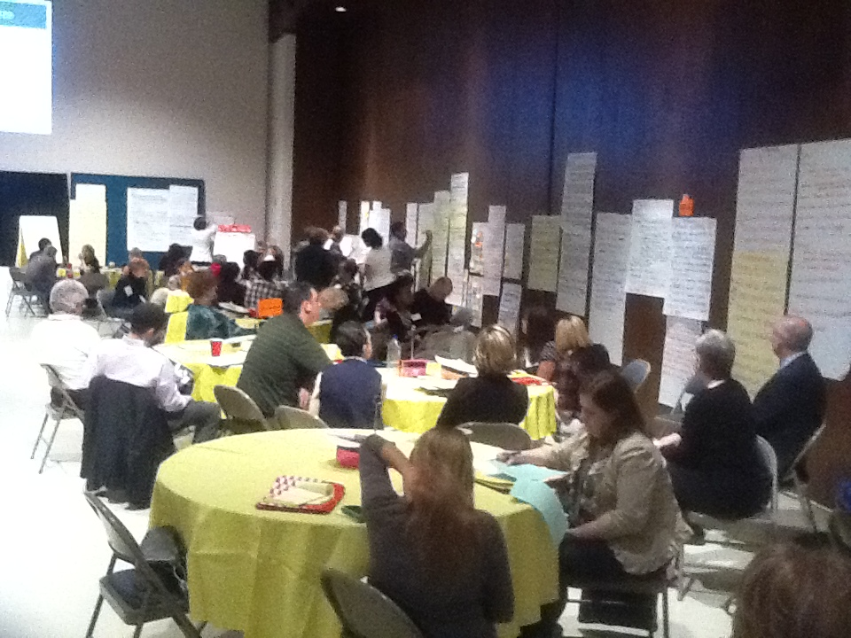

Slide 6
Platform
Access
Goal 1: By 2017, any person contacting any mental health agency will receive a hassle-free, reliable process to identify client needs.
Strategy 1: Develop a needs assessment tool used by all Tarrant County mental health agencies
Strategy 2: Utilize Tarrant Cares to agree to “Terms and Conditions” in order to allow release of records and sharing between agencies
Strategy 3: Have a designated computer in each facility which allows clients to fill out information

Slide 7
Platform
Access
Goal 2: Create a culture in Tarrant County where any person who contacts any mental health agencies receives available, appropriate services in a timely manner.
Strategy 1: Use technology effectively to share resources and availability, enabling hands-on navigation and warn (person-to-person) transfers and follow up
Strategy 2: Create a system of training for staff with whom clients have first contact, including language
Strategy 3: Establish a high-level intellectual problem-solving team as a stop-gap for intricate client needs

Slide 8
Platform
Access
Goal 3: By 2017, Tarrant County will provide easy access to diverse populations both culturally and linguistically.
Strategy 1: Develop more culturally competent points of access to care
Strategy 2: Educate the community on when and how to access mental health services

Slide 9
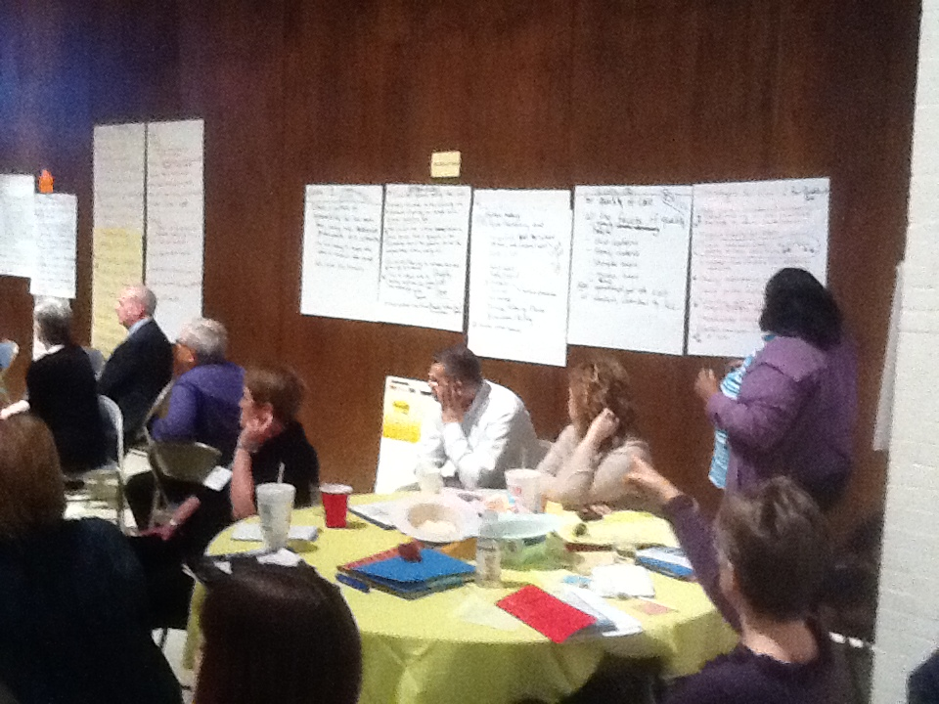

Slide 10
Platform
Sustainability
Goal 1: As a diverse community, continue to build collaborative support and opportunities for mental health and related services.
Strategy 1: Provide opportunity for agencies not involved in current partnerships
Strategy 2: Evaluate the perception of Mental Health Connection within the broadest and most diverse sense of community

Slide 11
Platform
Sustainability
Goal 2: Articulate an advocacy agenda resulting in sustainable resources and funding.
Strategy 1: Establish strong advocates on each legislative committee that has a role in policy or funding services
Strategy 2: Identify and cultivate multiple and additional funding sources for each service delivery mechanism
Strategy 3: Identify and develop key relationships

Slide 12
Platform
Sustainability
Goal 3: Outcome-focused, evidence-based research drives policy and community-based practices.
Strategy 1: Formalize communication process from field to research partners to advance two-way communication
Strategy 2: Model evidence-based practices in collaboration with community partners
Strategy 3: Mental Health Connection sponsors a research conference

Slide 13
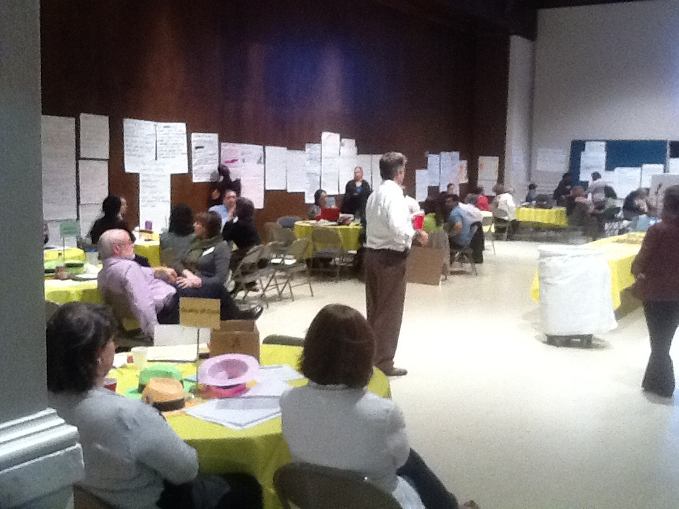

Slide 14
Platform
Mutually Reinforcing Partnerships
Goal 1: Providers who address mental health care needs will work together to integrate services and support.
Strategy 1: Strengthen community partnerships through cross-agency training, shared data system, and client-focused teams
Strategy 2: Define list of shared values and align community behaviors
Strategy 3: Examine the service delivery landscape to identify the gaps, overlaps and potential solutions

Slide 15
Platform
Mutually Reinforcing Partnerships
Goal 2: Forge partnerships among traditional and non-traditional partners to increase awareness in mental health issue and provide holistic care.
Strategy 1: Identify traditional and non-traditional stakeholders who are not participating in Mental Health Connection
Strategy 2: Conduct listening sessions with stakeholders
Strategy 3: Foster mutually beneficial relationships that increase awareness of mental health issues

Slide 16
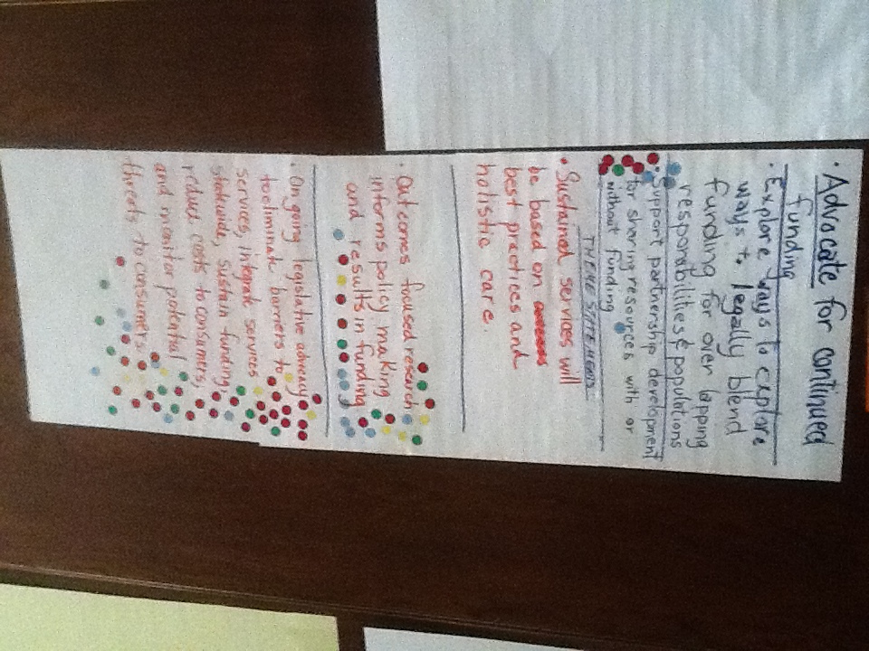

Slide 17
Platform
Engagement
Goal 1: Create a culture that supports the active participation of individuals, family members and associated partnership agencies.
Strategy 1: Create a linkage system to reduce barriers through quarterly meetings, monthly newsletters and social network site among professionals to share resources, programs, experiences, etc.
Strategy 2: Encourage peer support groups for similar disabilities through the Internet and other face-to-face connections

Slide 18
Platform
Engagement
Goal 2: Involve families in all groups, i.e. committees, boards at all levels of care, including the decision-making process of policies.
Strategy 1: Family members receive training to become family partners/leaders to affect future change and lead peer-to-peer support groups.
Strategy 2: Open communication between individuals and providers, which includes providers’ defining diagnosis and acronyms in layman’s terms, how the disability may affect the family (not just the individual, and providing the families with their rights at the time a disability is considered
Strategy 3: Provide training for individuals on policy development (from legislation)

Slide 19
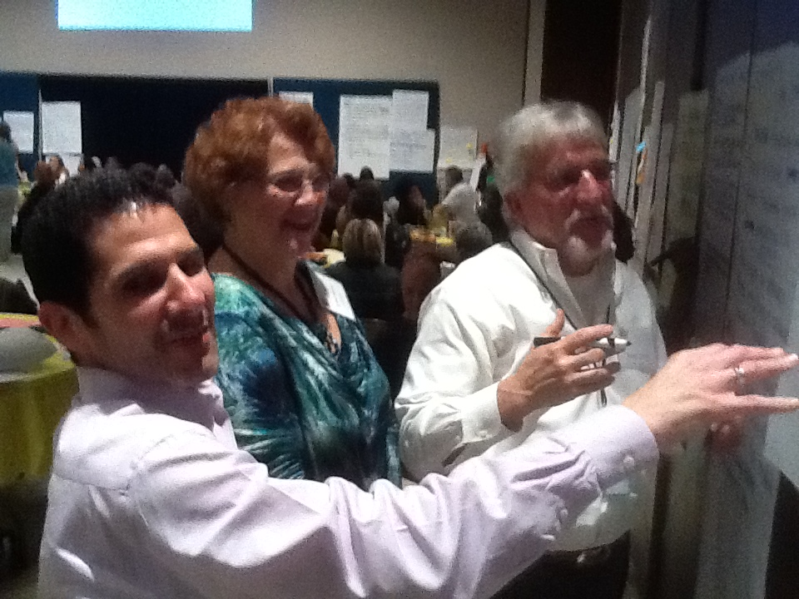

Slide 20
Platform
Workforce Development
Goal 1: Develop a well-informed, culturally and linguistically competent workforce that engages people.
Strategy 1: Engage in Human Resources – by June 1, Human Resources meetings of mental health organizations
Strategy 2: Provide direct education about the families we serve early in the recruitment/hiring process
Strategy 3: Provide training to improve cultural and linguistic competence

Slide 21
Platform
Workforce Development
Goal 2: Achieve adequate workforce compensation by 2017.
Strategy 1: Creative compensation/incentives
Strategy 2: Public awareness campaign
Strategy 3: Salary/compensation survey

Slide 22
Platform
Workforce Development
Goal 3: Utilize ongoing training and peer mentors to encourage effective and current service delivery.
Strategy 1: Peer mentoring program
Strategy 2: Partner with academic institution

Slide 23
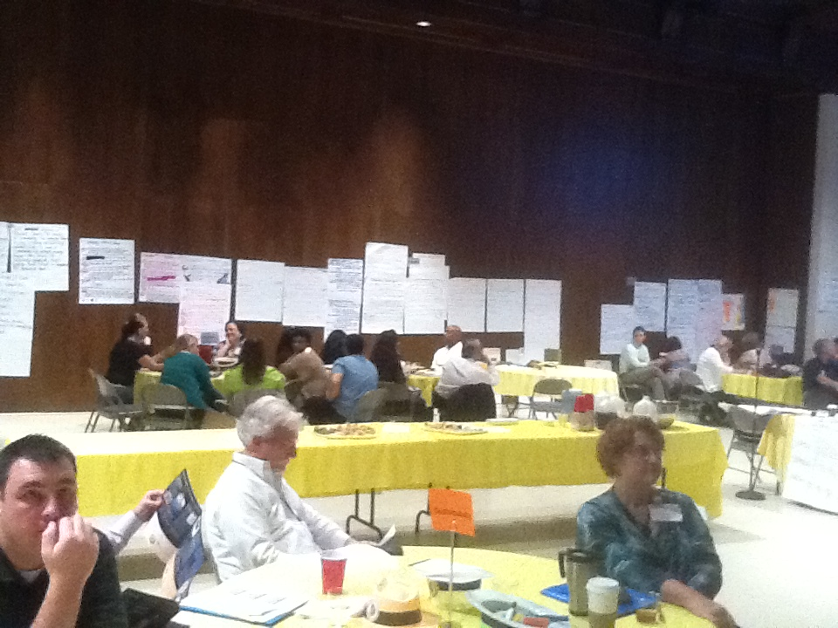

Slide 24
Platform
Outcomes
Goal 1: Have a supported infrastructure to collect cross-system data within a five-year period, such that outcomes are meaningful and can be used in the community.
Strategy 1: Core components of the Mental Health Connection vision will be identified by Dec. 20, 2012
Strategy 2: Mental Health Connection will develop a multi-agency Outcomes Committee by May 31, 2012
Strategy 3: Identify technology tools that allow efficient collection of data and modifiable reporting functions

Slide 25
Platform
Outcomes
Goal 2: Mental Health Connection members will utilize data, evaluation and outcomes to determine the effectiveness of the Tarrant County mental health delivery system.
Strategy 1: Mental Health Connection will develop a recommended set of outcome indicators by December 1, 2012, that agencies can add to their outcome process
Strategy 2: Provide technical assistance to member agencies to establish data pertaining to the recommended outcomes by December 31, 2013
Strategy 3: Member Mental Health Connection agencies can/will submit data for recommended outcomes by March 31, 2017

Slide 26
Platform
Outcomes
Goal 3: Effectively communicate system-wide outcomes at regular intervals to the community.
Strategy 1: Mental Health Connection will identify stakeholders and encourage buy-in throughout the community
Strategy 2: Identified stakeholders will create an adaptive, comprehensive Outcomes Communication Plan
Strategy 3: Mental Health Connection implements communication plan

Slide 27
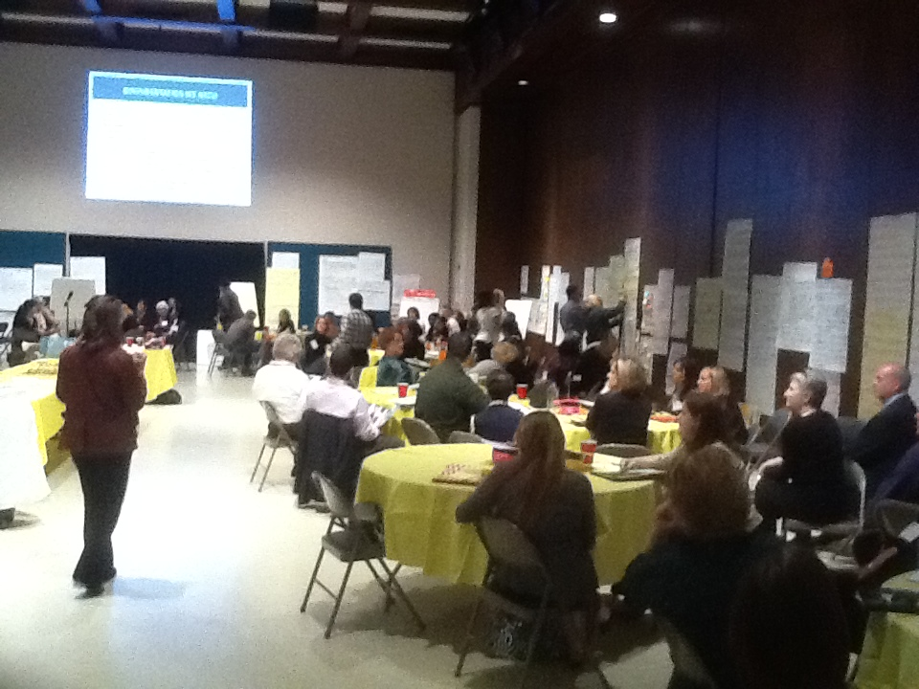

Slide 28
Participants
ACH Child and Family Services
AIDS Outreach Center
Alliance for Children
Arlington ISD
Arlington Life Shelter
Arlington Police Department
Catholic Charities
Child Protective Services
Child Study Center
City of Arlington Park & Rec
City of Fort Worth
Community Volunteers
Cook Children's Healthcare System
Cook Children's Medical Center
Crime Victims Council
Family Members
Fort Worth ISD
Fort Worth Police Department
Hand in Hand
IDD Needs Council
JPS Health Network
Lena Pope Home, Inc.
Mental Health America of Greater Tarrant County
MHMR of Tarrant County
Office of Judge Glen Whitley
Office of Representative Vicki Truitt
Office of State Senator Wendy Davis
One Safe Place
Pecan Valley Center
Presbyterian Night Shelter
Private Practitioners
Recovery Resource Council
Safe Haven of Tarrant County
Samaritan House
Santa Fe Youth Services
Senior Citizens Services
Sundance Behavioral Health
Tarrant County Challenge, Inc.
Tarrant County CSCD
Tarrant County Juvenile Services
Tarrant County Mental Health Court
Tarrant County Public Health
Tarrant County Veterans Court Teen Lifeline
Texas Christian University
Texas Department of Assistive & Rehabilitative Services
Texas Department of Family & Protective Services
Texas Health & Human Services Commission
Texas Health Harris Methodist Springwood
Texas Health Institute
The Art Station
The Excel Center
The Parenting Center
The Women's Center of Tarrant County, Inc.
Trauma Support Services of North Texas
Union Gospel Mission
United Way of Tarrant County
University of Texas at Austin
UNT Health Science Center
UTA School of Social Work
UTA School of Nursing
World Relief
Youth Advocate Program
YWCA Fort Worth and Tarrant County

